Slide 1
A World Connected: Advancing Assistive Technologies for Global Equity

Slide 2
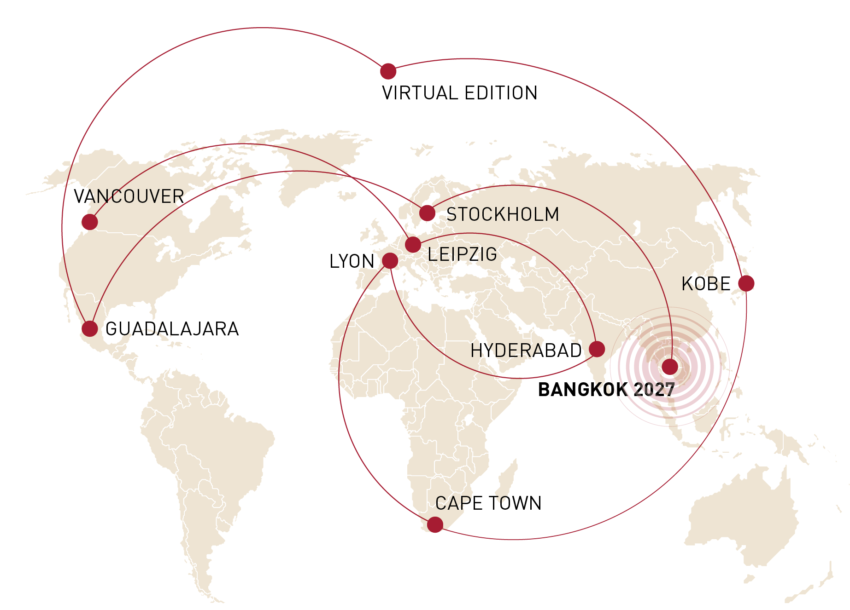
First ISPO World Congress in Southeast Asia
What you can expect
2,500 participants from around the globe
100 international exhibitors
6 keynotes
120 sessions with over 300 presenters

Slide 3
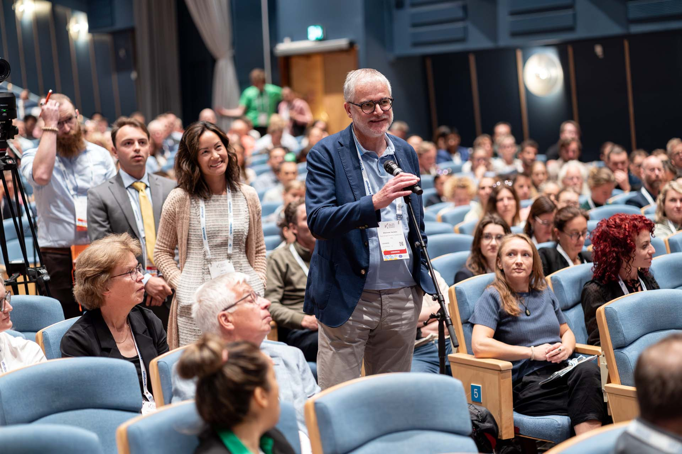
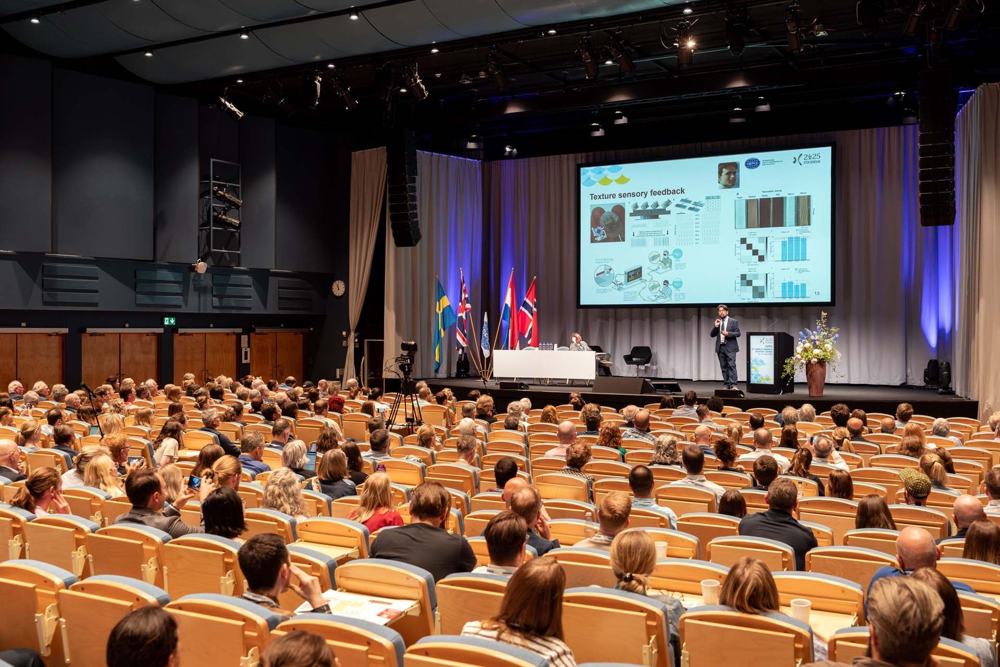

High-quality programme
A World Connected: Advancing Assistive Technologies for Global Equity
CALL FOR PAPERS
Symposia, instructional courses, technical track presentations: by 29 June
Free papers and poster abstracts, 3MT student competition: by 7 September
Participants will enjoy a high-quality scientific and technical programme presented by a variety of professionals from various disciplines and countries.

Slide 4
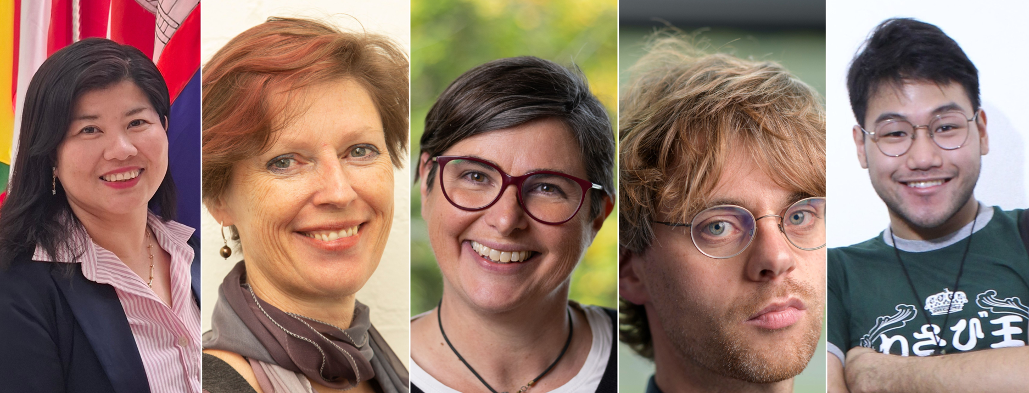
Keynote speakers
A World Connected: Advancing Assistive Technologies for Global Equity
Sisary Kheng, Natasha Layton, Nerrolyn Ramstrand and Massimo Sartori will represent global perspectives on rehabilitation systems, assistive technology policy, user-centred care and cutting-edge robotics.
The IC2A Inspirational Lecture will be held by Zy Kher Lee, whose personal story stands for resilience and determination.

Slide 5
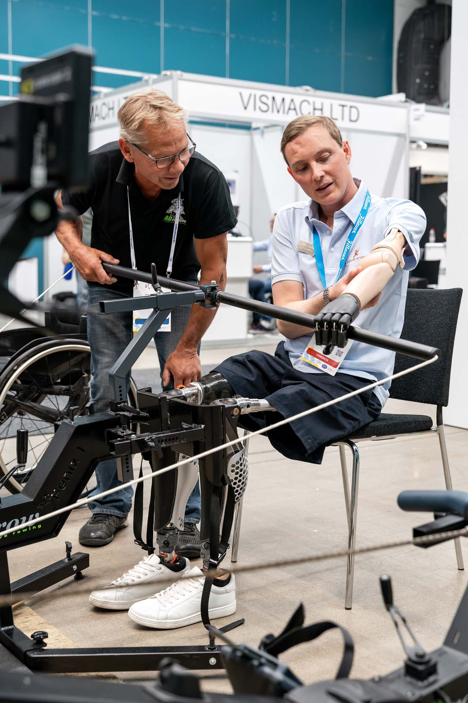
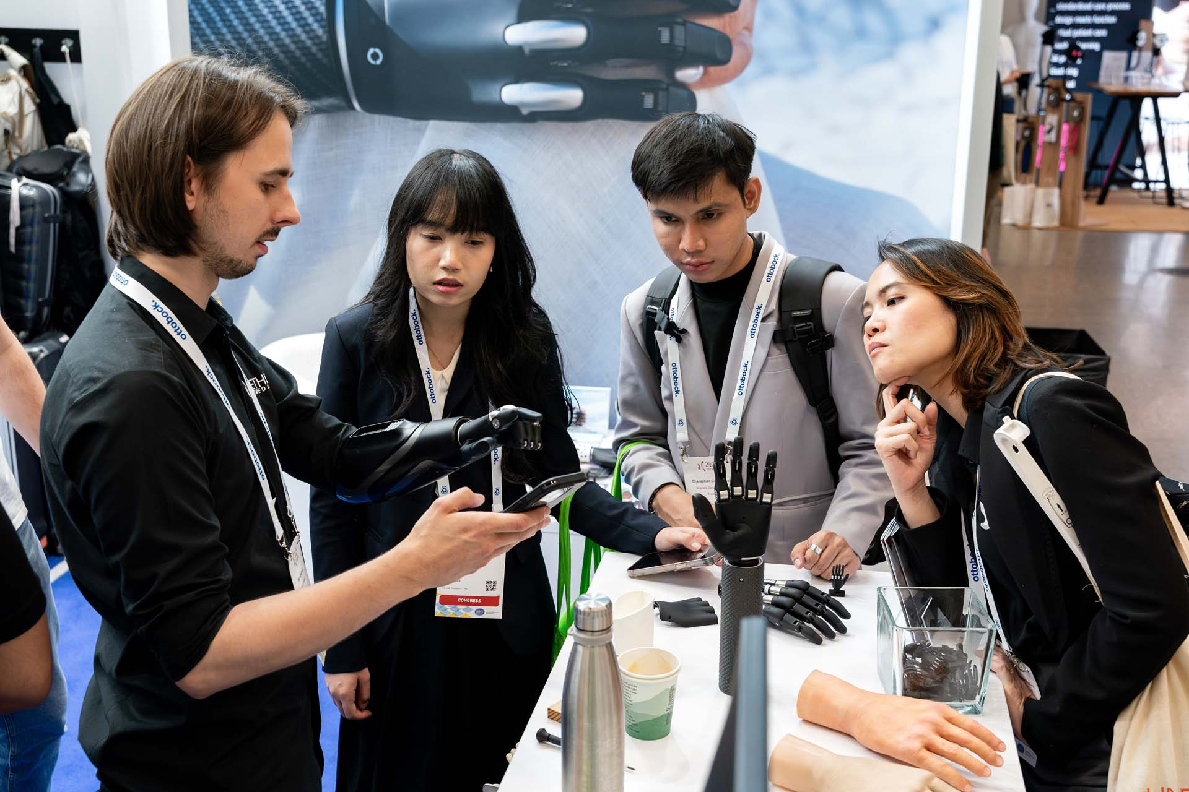
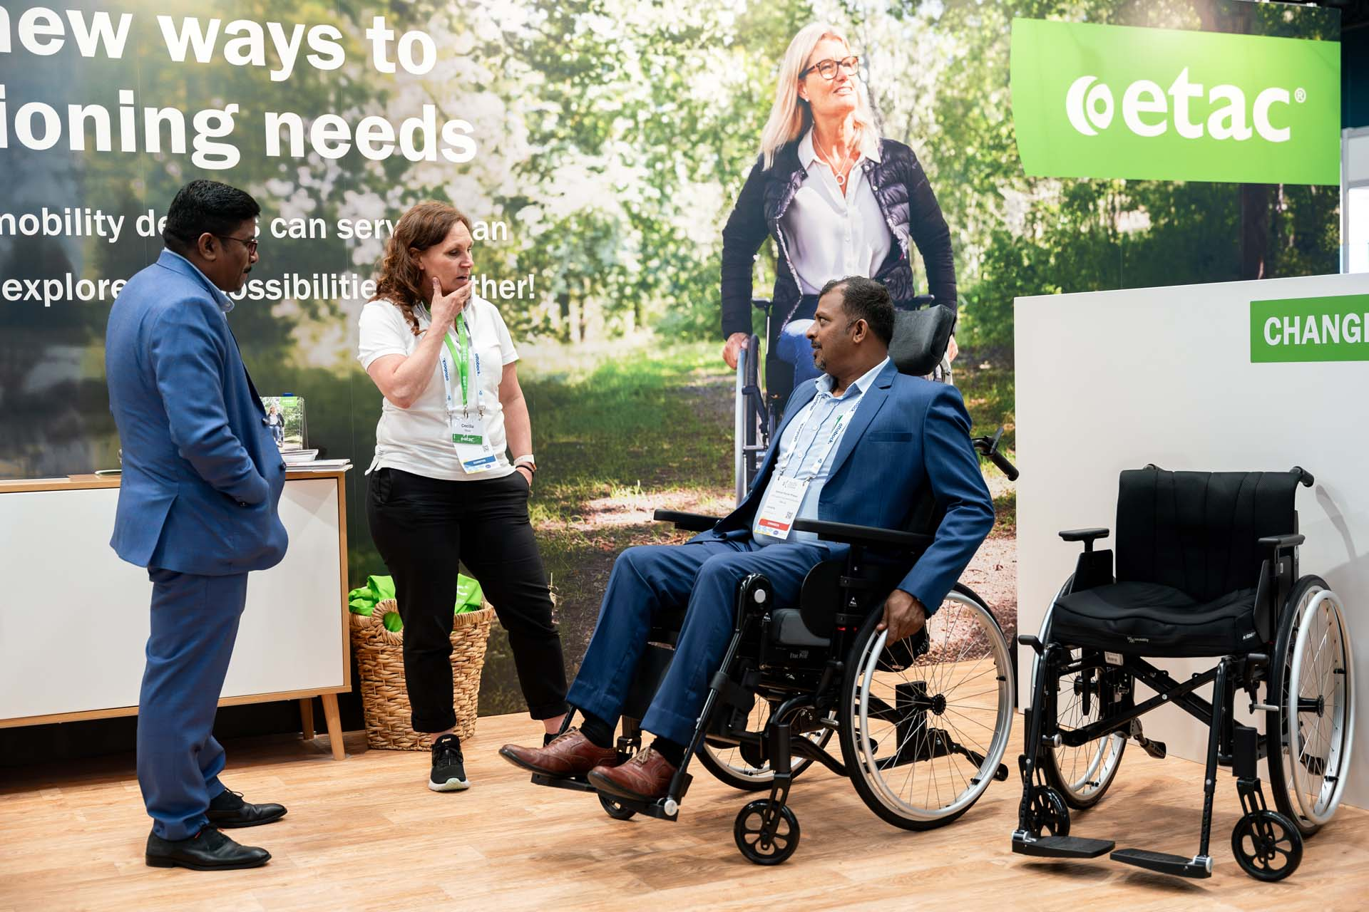
International exhibition
Get a comprehensive market overview
The industry exhibition will showcase the entire spectrum of products and services related to assistive technologies for mobility. Encounter companies from around the world – from the global players to young innovative companies to NGOs, and anything in between.

Slide 6

See you in Bangkok next year!
ISPO and the National Member Society of Thailand look forward to welcoming you!
SOCIAL HIGHLIGHTS
Welcome Reception on
22 March
A social and tour programme showcasing the Thai culture will be organised for you!

